Slide 1

BUSINESS CONTRACT VALIDATION
A COMPREHENSIVE SOLUTION FOR AUTOMATED CONTRACT VALIDATION

Slide 2






INTRODUCTION
OUR CONTRACT VALIDATION WEBSITE OFFERS ROBUST FEATURES FOR EXTRACTING,PROCESSING AND VALIDATING CONTRACT CALUSES.THE SOLUTION LEVERAGES POWERFUL NLP TECHNIQUES AND PRE-TRAINED MACHINE LEARNING MODELS TO ENSURE ACCURATE CLASSIFICATION AND DETECTION OF DEVIATIONS IN CONTRACT DOCUMENTS

Slide 3

KEY FEATURES
Text Extraction: Supports PDF and DOCX formats for seamless text extraction.
Text Processing: Utilizes NLTK and spaCy for comprehensive text preprocessing including tokenization, stopword removal and lemmatization.
Clause Segmentation: Advanced algorithms to accurately segment text into meaningful clauses .
Clause Classification: Classifies clauses into predefined categories using machine learning models.
Deviation Detection: Identifies deviations from standard templates using cosine similarity and sentence transformers.
Highlighting: Highlights the deviation detected areas based on deviation percentage.

Slide 4

TECHNICAL DETAILS
THE SOLUTION INTEGRATES SEVERAL ADVANCED TECHNOLOGIES . SOME OF THEM ARE AS FOLLOWS:
PDF AND DOCX PARSING WITH PDFPLUMBER AND PYTHON-DOCX.
NLP PREPROCESSING WITH NLTK AND spaCy.
MACHINE LEARNING CLASSIFICATION USING SCIKIT-LEARN.
SEMANTIC SIMILARITY MEASUREMENT WITH SENTENCE TRANSFORMERS.
WEB APPLICATION BUILT WITH FLASK FOR USER INTERACTION AND FILE PROCESSING.

Slide 5
CODE
Imports and Initial Setup
Libraries and Modules: Various Python libraries are imported, such as os, re, time, pdfplumber, nltk, pandas, joblib, sklearn, flask, docx,
sentence_transformers, logging, spacy, and torch.
These libraries handle file operations, text extraction, preprocessing, machine learning, and web application functionality.
NLTK Downloads: Necessary NLTK data packages (punkt, stopwords, wordnet) are downloaded for text processing.
spaCy Model: The en_core_web_sm spaCy model is loaded for NLP tasks.
Logging Configuration: Logging is set up to record application events in contract_processing.log.
Helper Functions
log_processing: Logs the start of file processing.
extract_text_from_pdf:Extracts text from PDF files using pdfplumber.
extract_text_from_docx:Extracts text from DOCX files using python-docx.
preprocess_text: Preprocesses text by tokenizing, removing stopwords, and lemmatizing using NLTK.
preprocess_text_with_spacy:Preprocesses text using spaCy, removing stopwords and lemmatizing.
segment_clauses_advanced: Segments text into clauses using regex patterns and spaCy sentence segmentation.
segment_clauses_nlp: Segments text into clauses using regex patterns and manual paragraph splitting.
segment_clauses_two_pass: A two-pass clause segmentation method, first identifying potential headers and then splitting the text into clauses.
post_process_clauses: Refines clause segmentation by removing metadata, checking lengths, and handling clause concatenation.

Slide 6
Project Directory and Model Loading
Project Root and Models Directory: Defines and prints the paths for the project root and models directory.
Model Loading: Loads the pre-trained vectorizer, classifier, label encoder, Sentence Transformer model, template embeddings, and KMeans clustering model from the specified paths.
Standard Template Clauses: Loads standard template clauses and their categories from a CSV file.
Core Functions
classify_clauses: Classifies clauses into categories using a pre-trained vectorizer and classifier.
find_most_matching_template_optimized: Finds the most matching template clause using optimized clustering and semantic similarity.
highlight_deviations: Highlights deviations between user clauses and template clauses, categorizing the deviations based on similarity percentages.
prepare_highlighted_contract: Prepares the final highlighted contract with deviations marked using HTML span elements.
annotate_data: Manually annotates clauses with categories (likely used during training).
train_model: Trains a classification model on annotated clauses and saves the trained models.
validate_model: Validates the classification model using annotated clauses and returns accuracy.
initialize_ner_mode(): Initializes the named enitity recognition( NER) model and tokenizer using OpenVINO.
initialize_summarizer(): Initializes the BART summarizer model and tokenizer for generating contract summaries.

Slide 7
Flask Application
Flask App Initialization: Initializes the Flask application and sets up the GPT models.
Routes:
front_page: Renders the front page (front_page.html).
upload_file: Handles file uploads, extracts and preprocesses text, segments clauses, classifies them, finds template matches and deviations, and renders the results.
feedback: Handles user feedback, logging it to a file and redirecting to a thank you page.
thank_you: Renders a thank you page (thank_you.html).
Running the Application
Main Execution: Runs the Flask application in debug mode, with use_reloader=False to prevent multiple reloads.

Slide 8
DETAILED WORKFLOW
Setup and Initialization
Import Libraries and Configure Environment:
Import necessary libraries.
Set up logging for tracking the process.
Initialize Models and Tokenizers:
Load spaCy model for text processing.
Initialize NER model with OpenVINO.
Initialize summarizer model (BART).
Define Utility Functions:
log_processing: Log file processing activities.
extract_text_from_pdf, extract_text_from_docx: Extract text from PDF and DOCX files.
preprocess_text_with_spacy: Preprocess text using spaCy.
segment_clauses_advanced: Segment text into clauses.
post_process_clauses: Post-process clauses to ensure proper segmentation.

Slide 9
DETAILED WORKFLOW
2. Data Preparation
Load Standard Templates:
Load and preprocess standard templates from a specified directory.
Segment and store clauses from templates in a DataFrame.
Train Models:
Load training data from a CSV file.
Preprocess clauses and split data into training and testing sets.
Train vectorizer, classifier, and label encoder.
Save trained models for future use.
Evaluate the trained model and generate evaluation metrics.

Slide 10
DETAILED WORKFLOW
3. Contract Processing
Extract and Preprocess Contract Text:
Extract text from the user-provided contract (PDF or DOCX).
Preprocess the extracted text to prepare for clause segmentation and classification.
Segment and Classify Clauses:
Segment the contract text into clauses.
Classify each clause using the trained classifier.
Store classified clauses and their predicted categories.

Slide 11
DETAILED WORKFLOW
4. Matching and Deviation Analysis
Find Matching Templates:
Use semantic similarity and FAISS to find the most similar template clauses.
Retrieve top matching templates for each user clause.
Highlight Deviations:
Calculate deviation percentages between user clauses and matched template clauses.
Categorize deviations based on their severity (high, significant, moderate, minor, minimal).
Store deviation details for each clause.

Slide 12
DETAILED WORKFLOW
5. Summarization and Output
Summarize Contract:
Use both abstractive and extractive methods to generate a summary of the contract.
Combine summaries and remove duplicate sentences for the final summary.
Prepare Highlighted Contract:
Highlight clauses in the contract based on deviation types.
Generate a combined text with highlighted deviations.
Save and Return Results:
Save the highlighted contract and evaluation results.
Return or display the processed contract with deviations and summaries.

Slide 13
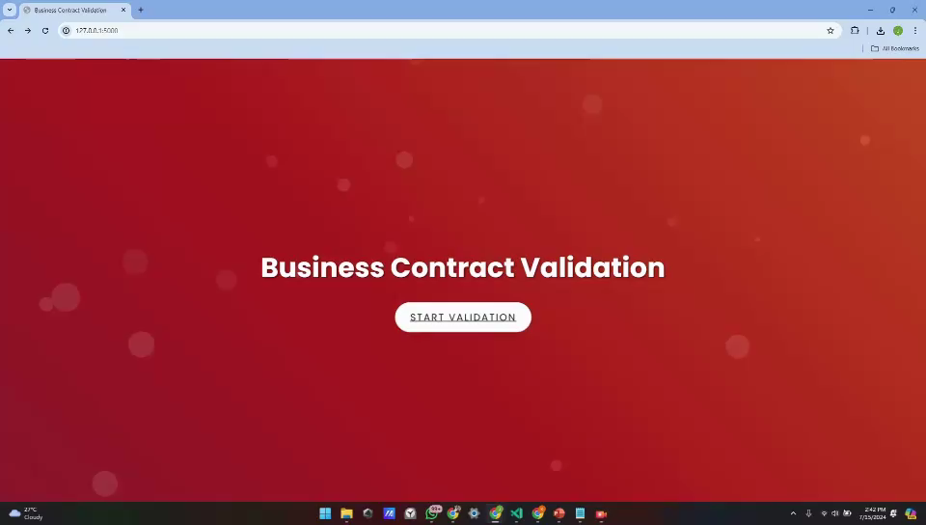
DEMO VIDEO

Slide 14
CONCLUSION
OUR CONTRACT VALIDATION WEBSITE OFFERS INCRESED EFFICIENCY AND ACCURACY IN CONTRACT REVIEW.
AUTOMATED DETECTION OF NON-STANDARD CLAUSES.
REDUCED RISK OF CONTRACTUAL DISCREPANCIES.
USER-FRIENDLY INTERFACE FOR EASY UPLOAD AND PROCESSING OF CONTRACTS.
DETAILED REPORTING OF CONTRACT ANALYSIS RESULTS.

Slide 15

THANK YOU
JOBINJOY PONNAPPAL
KAVYA RAJ P
ALEENA THOMAS
MOHAMMED AMAAN

